Slide 1
Content and Contextual Analysis of Selected Primary Sources in Philippine History

Slide 2

LEARNING OBJECTIVES
At the end of this module, students should be able to:
1. To determine the contribution of different kinds of primary sources in understanding
Philippine history.
2. To analyze the content and context of different kinds of primary sources.
3. To develop critical and analytical skills with exposure to primary sources.

Slide 3
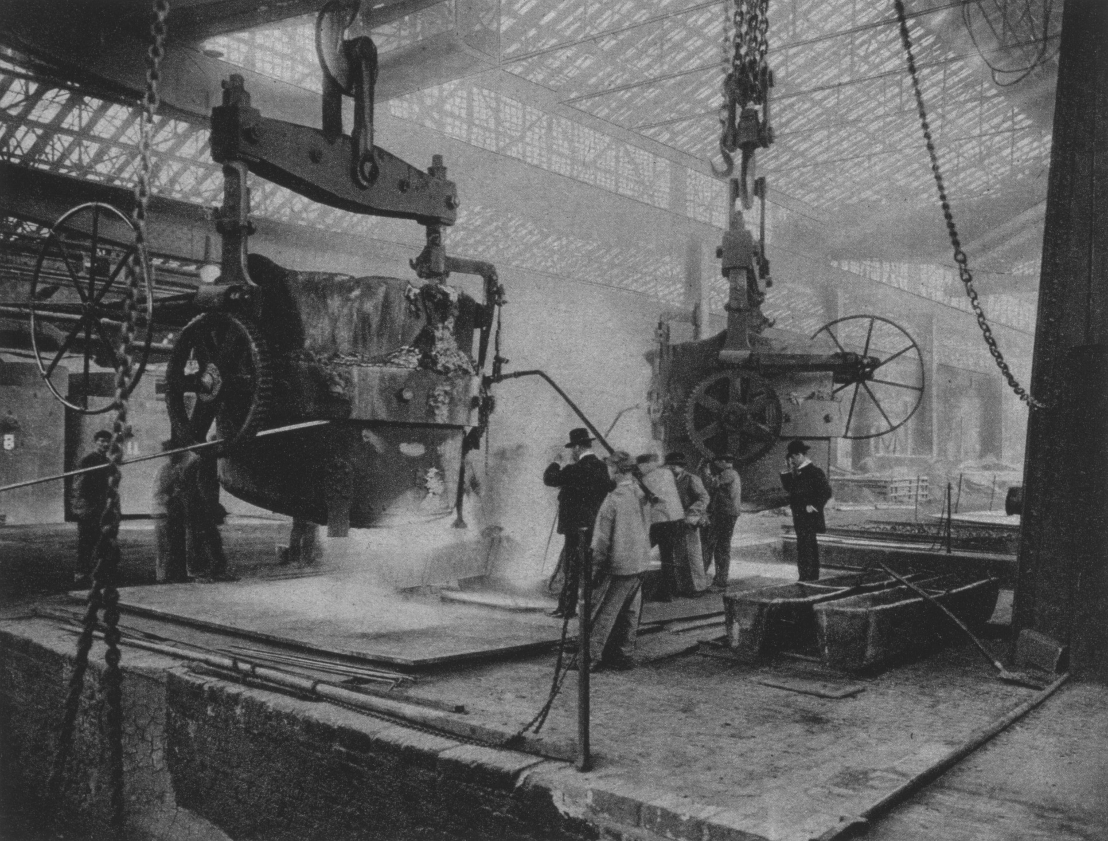
First Voyage Around the World
Kartilya ng Katipunan
Philippine Independence
Political Cartoon
Corazon Aquino’s speech

Slide 4
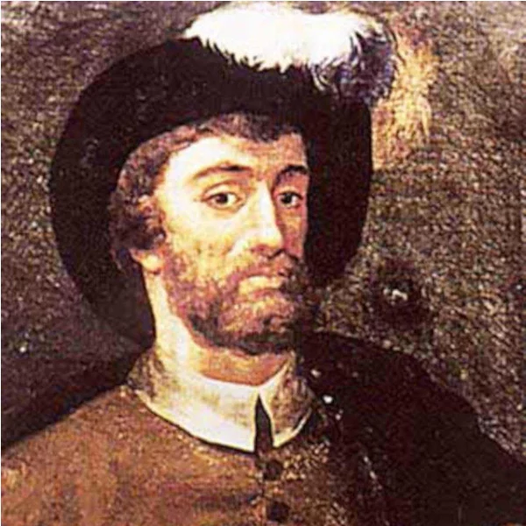
GUESS WHO?
T I O N O A N
ATEAPIGFT

Slide 5
ANTONIO
PIGAFETTA

Slide 6
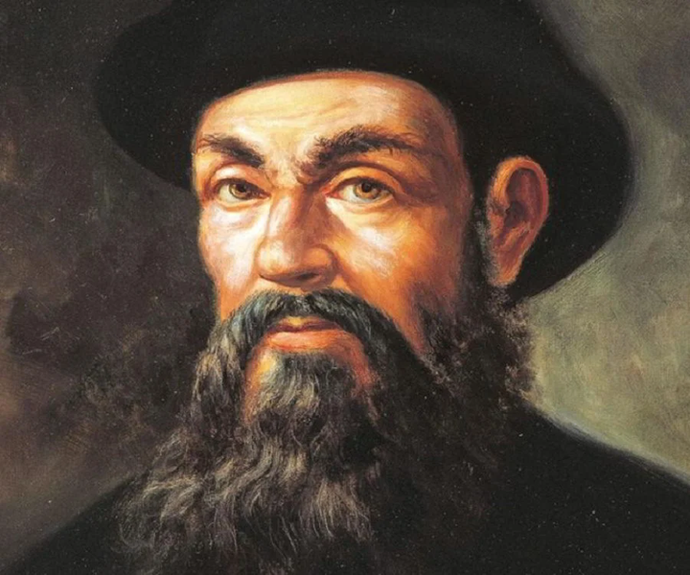
ANTONIO
PIGAFETTA
FERDINAND MAGELLAN

Slide 7
First Voyage Around the World by Magellan
by Antonio Pigafetta
FERDINAND MAGELLAN
February 3, 1480 - April 25, 1521
Portuguese explorer
Circumnavigate the globe.
Only 22 out of 270 crew members made it back to Europe.
Victoria is the only ship which completed the voyage.

Slide 8
Antonio Pigafetta
a chronicler
a wealthy Venetian scholar and explorer, born in Vicenza, Italy.
joined the expeditions to the Spice Islands
“First Voyage of the World by Magellan”
produced four manuscript accounts which are extant
- to document and chronicle the historic expedition to find a western route to the Spice Islands (Indonesia) and the circumnavigation of the globe.

Slide 9
CHRONOLOGY
OF THE VOYAGE

Slide 10
1518 - Magellan signed an agreement with King Charles I of Spain
1519 - First voyage of Magellan
1520 - Reached the Strait of Magellan
1521 - Arrived in Philippines (March)
1521 - Battle of Mactan (April 27 - midnight)
1521 (November) - New Commander (Juan Sebastian Elcano)
1522 - (May 22) Victoria passes the Cape of Good Hope and enters Atlantic ocean.
1522 - (Sept. 6) - Victoria returns to Sanlucar.
1522 - (Sept. 8) - Arrived in Seville.
CLASS REQUIREMENTS
WHAT YOU'LL BE DOING
Presentations are tools that can be used as lectures, speeches, reports, and more.

Slide 11
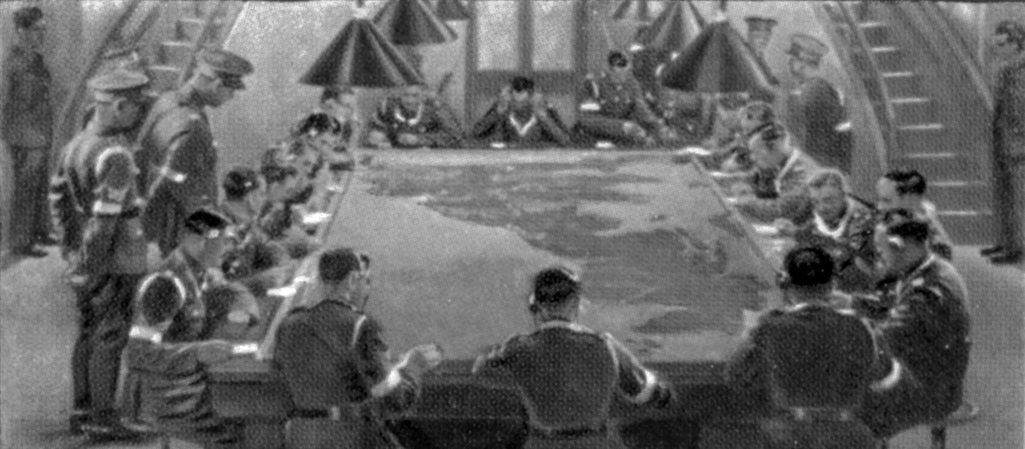
The KKK and the “Kartilya ng Katipunan”

Slide 12
KKK is arguably the most important organization formed in the Philippine history.
envisioned a united Filipino nation
Revolts and Ilustrados
Katipunan document: Kartilya ng Katipunan
written by: Emilio Jacinto (1896)
April 15, 1897 - Bonifacio appointed Jacinto as a commander of Katipunan

Slide 13
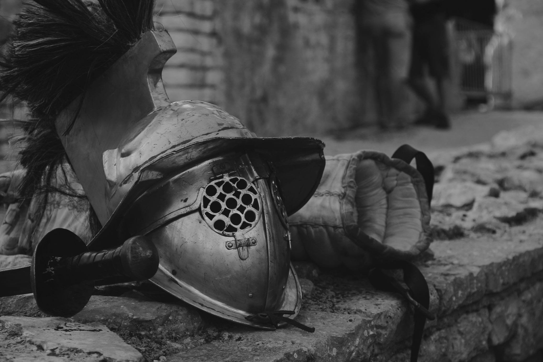
Proclamation of the Philippine Independence

Slide 14
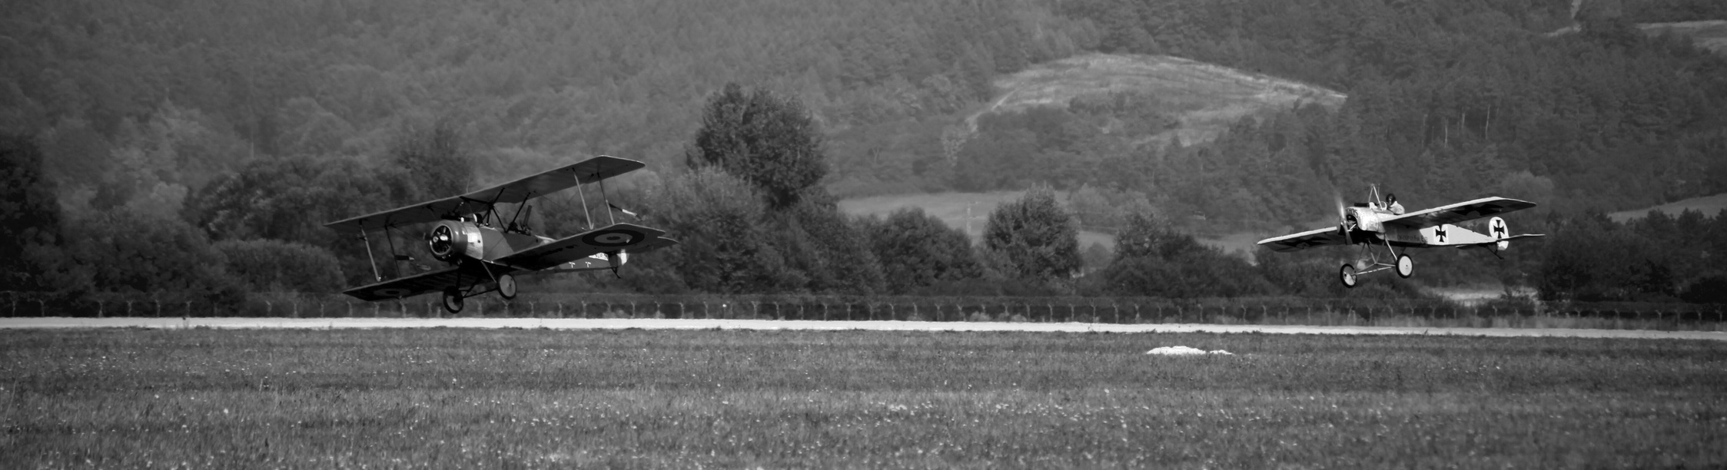
CONTENTS OF THE PROCLAMATION
12 June 1898, Philippine Independence
proclamation commenced with a characterization of the conditions in the Philippines during the Spanish colonial period.
The proclamation mentioned demonstrates the justifications behind the revolution against Spain.
a brief historical overview of the Spanish occupation since Magellan's arrival in Visayas until the Philippine revolution
invoked that the established republic would be led under the dictatorship of Emilio Aguinaldo.
explanation on the Philippine flag that was first waved on the same day.

Slide 15
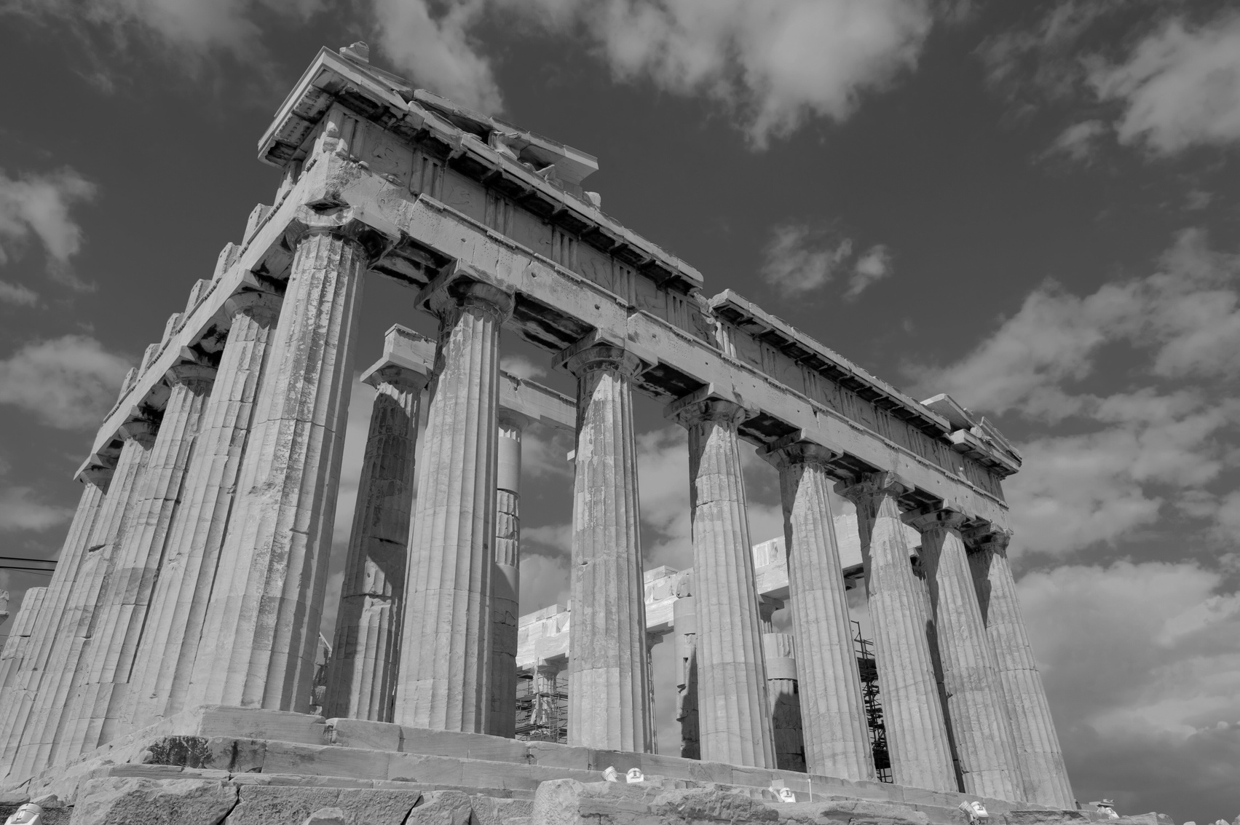
GROUP WORK:
Identify a primary source in Philippine history from the discussion. Write an essay discussing (1) the importance of the text, (2) the background of the text’s author, (3) the context of the document, and (4) the text’s contribution to understanding Philippine history.

Slide 16
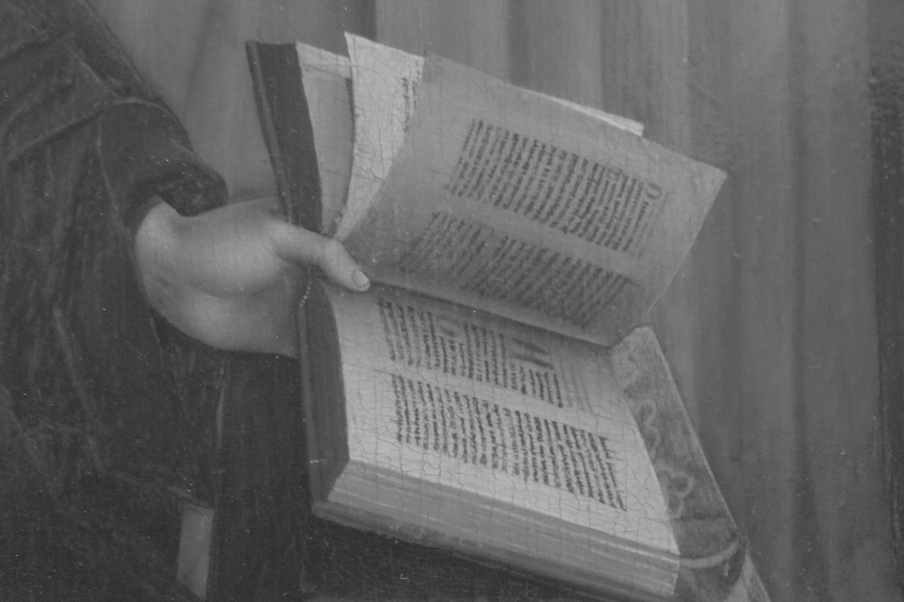
A Glance at Selected Philippine Political Caricature in Alfred McCoy’s Philippine Cartoons: Political Caricature of the American Era (1900 - 1941)

Slide 17

Political cartoon, according to Knieper (2018) are drawings (often including caricature) made for the purpose of conveying editorial commentary on politics, politicians, and current events.
Philippine political cartoons gained full expression during the American era.
The scandals, struggles and social changes of the American colonial period gain an immediacy in these graphic images that eludes even the most eloquent historical prose.

Slide 18
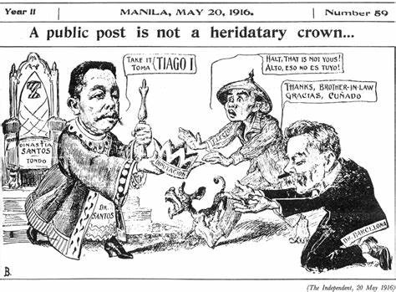

Slide 19
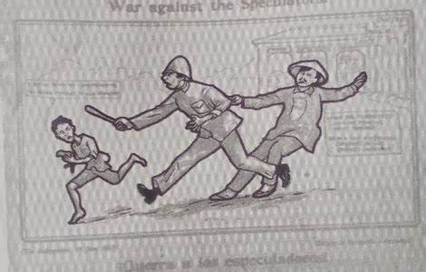

Slide 20
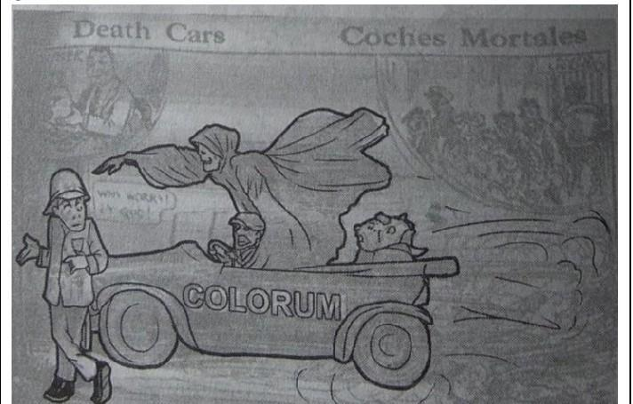

Slide 21
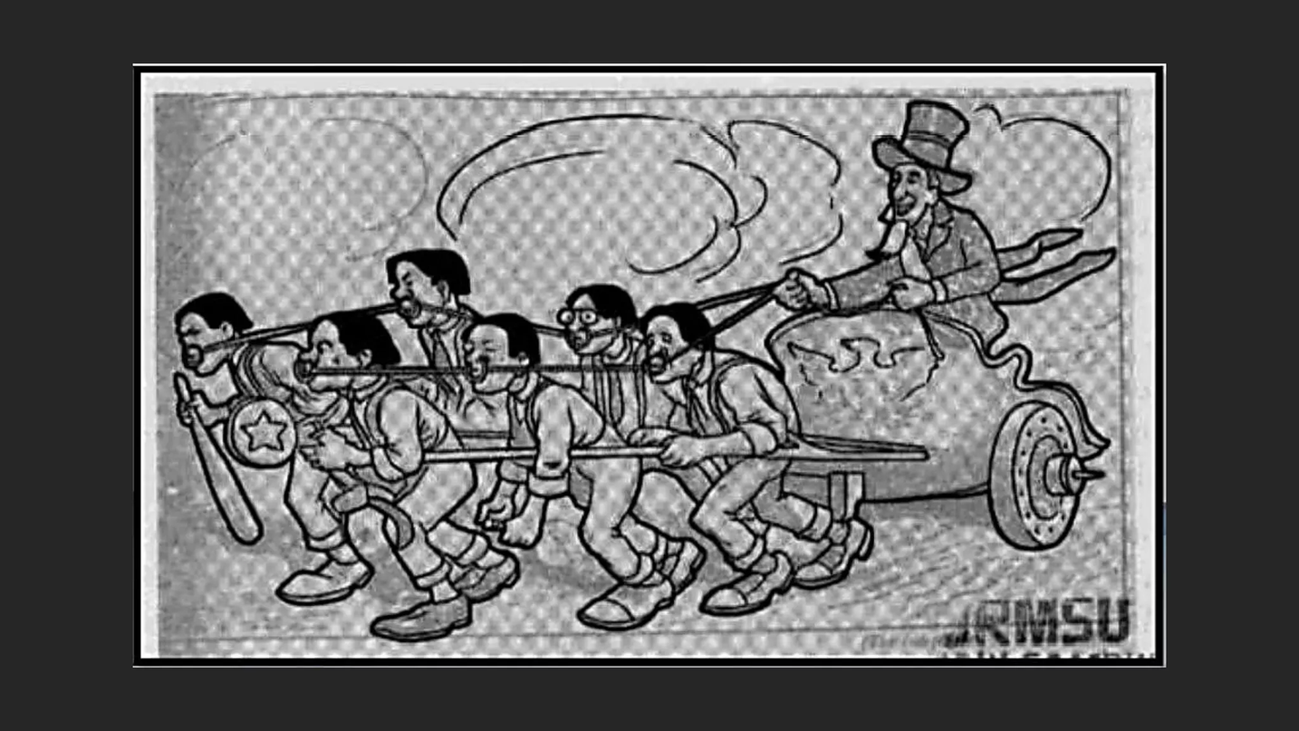

Slide 22
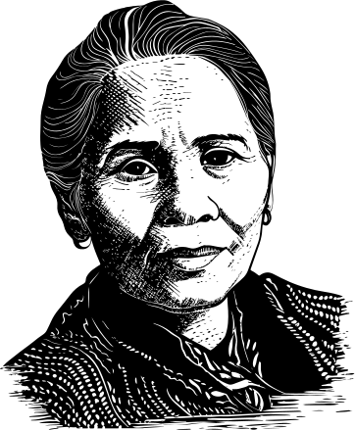
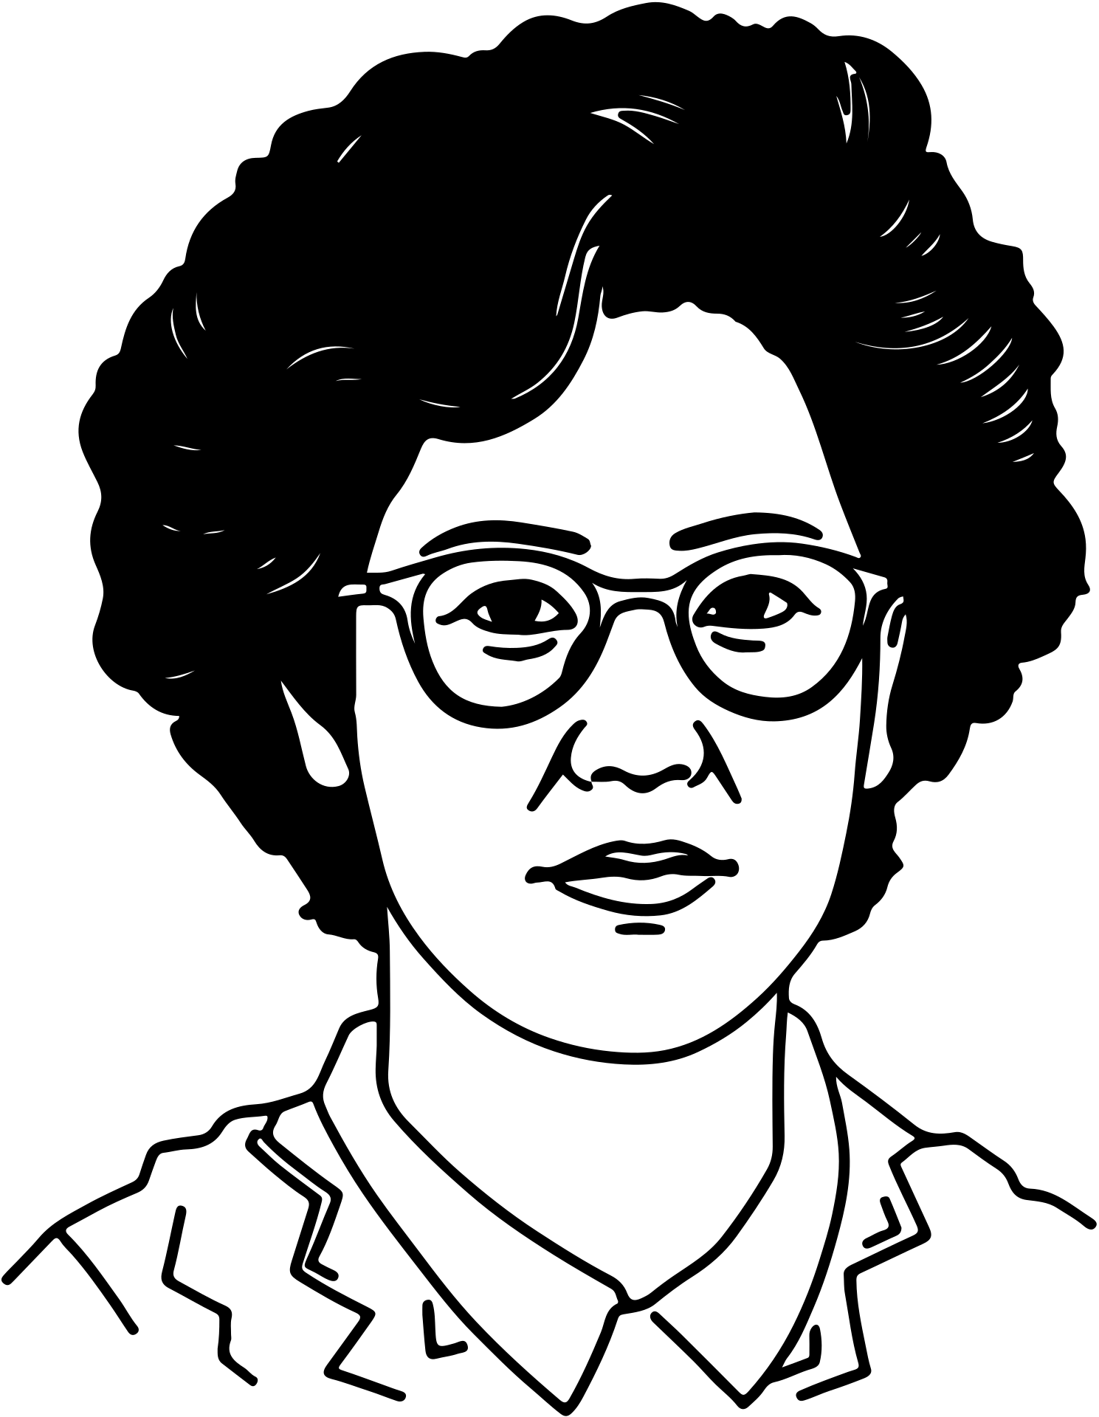
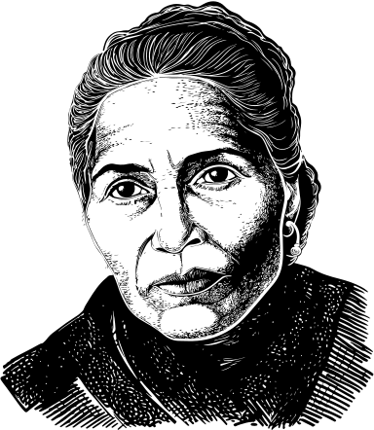
Revisiting Corazon Aquino’s Speech Before the U.S. Congress

Slide 23
ASSIGNMENT:
Make your own caricature conveying your editorial commentary to our politics / politicians / economics / current events.
NAME: COURSE: DATE:
CARICATURE
ANALYSIS/EXPLANATION

